Slide 1
SWIFT 2025 Changes

Slide 2
SWIFT - What changes…
Format MT to MX transaction
Address in structured format
Compliance Timelines….
CHANGE | OPTIONAL | MANDATORY
MT to MX |  | November 2025
Structures address adherence | November 2025 | November 2026
Processes Impacted :
Cross border Payments
Cross border trade Transactions
SWIFT reconciliation
Customer On-boarding

Slide 3
MT to MX Changes

Slide 4
What is MX….
Message type (MT) messages are structured according to the specifications of the ISO 15022 standard using the FIN protocol. MX messages are structured according to the ISO 20022 standard and use the XML protocol.
Message structures
A three-digit number follows MT messages:
The first digit indicates the message category
The second digit indicates the message group
The third digit specifies the message type
The MX message is composed of four parts:
Four alpha characters indicate the message type
Three alphanumeric characters identify the message number
Three numeric characters highlight the message variant
Two numeric characters indicate the version number

Slide 5
Why MX….
Key Benefits
Richer Data: MX messages can carry significantly more information than MT messages. It allows for more transparent communication and reduces the need for additional messages or clarification requests.
Improved Efficiency: The structured data format of MX messages makes them easier to process and automate, leading to faster transactions and reduced operational costs.
Enhanced Transparency: The increased data detail in MX messages provides better transparency for all parties involved in a transaction, reducing the risk of errors and fraud.
Global Standardization: The ISO 20022 standard behind MX ensures consistency across regions and financial institutions, simplifying cross-border payments.
Flexibility: The MX format allows for customization to accommodate specific needs and future changes in the financial industry.
Improved Compliance: The richer data allows for easier compliance with regulatory requirements, particularly for complex transactions.
Improved Analytics : may help banks and other entities comply with sanctions and anti-money laundering requirements

Slide 6
Who is Impacted….
Financial Institutions (Banks, Credit Unions) need to update their internal systems and processes to handle MX messages. It can involve significant investments in technology and training.
Corporates and Businesses: Businesses that make or receive international payments must adapt their systems to generate and receive MX messages. It may require collaboration with their banks for a smooth transition.
Fintech Companies: Fintech companies involved in payment processing must adapt their systems to the new standard.
Payment Service Providers (PSPs): PSPs, such as remittance companies, will need to adjust their infrastructure to handle MX messages.
SWIFT Network: SWIFT, the global messaging platform for financial transactions, is a significant driver of the migration. By the deadline, it will update its infrastructure to handle MX messages exclusively.

Slide 7
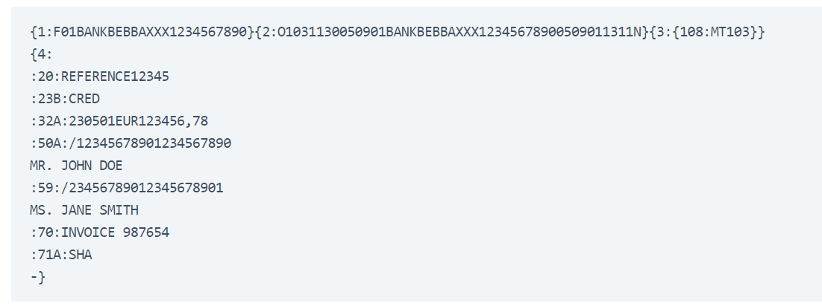
MT FORMAT - Sample

Slide 8
XML FORMAT Sample
<breakfast_menu>
<food>
<name>Belgian Waffles</name>
<price>$5.95</price>
<description>Two of our famous Belgian Waffles with plenty of real maple syrup</description>
<calories>650</calories>
</food>
<food>
<name>Strawberry Belgian Waffles</name>
<price>$7.95</price>
<description>Light Belgian waffles covered with strawberries and whipped cream</description>
<calories>900</calories>
</food>
<food>
<name>Berry-Berry Belgian Waffles</name>
<price>$8.95</price>
<description>Light Belgian waffles covered with an assortment of fresh berries and whipped cream</description>
<calories>900</calories>
</food>
<food>
<breakfast_menu>

Slide 9
Structured Address

Slide 10
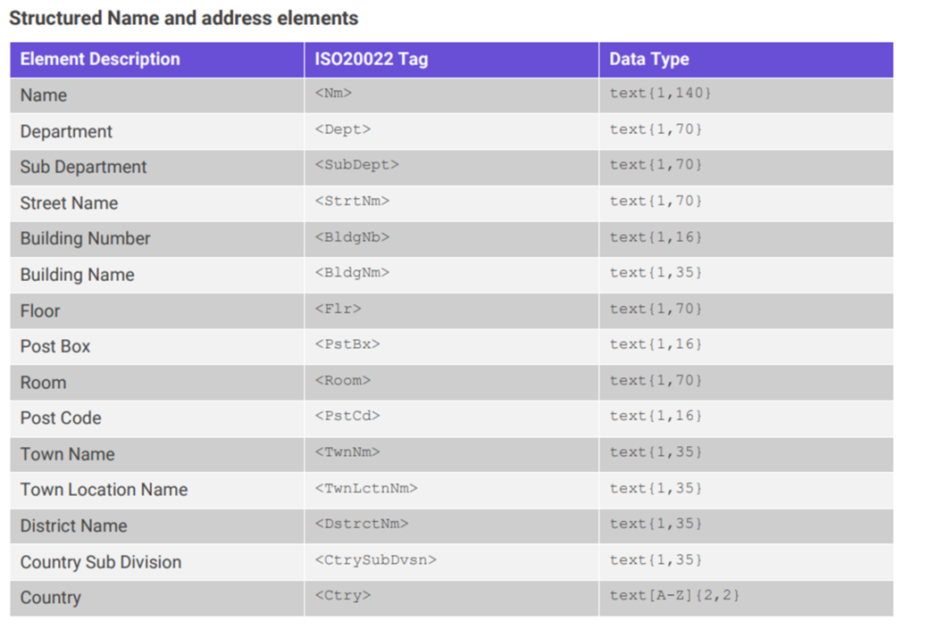
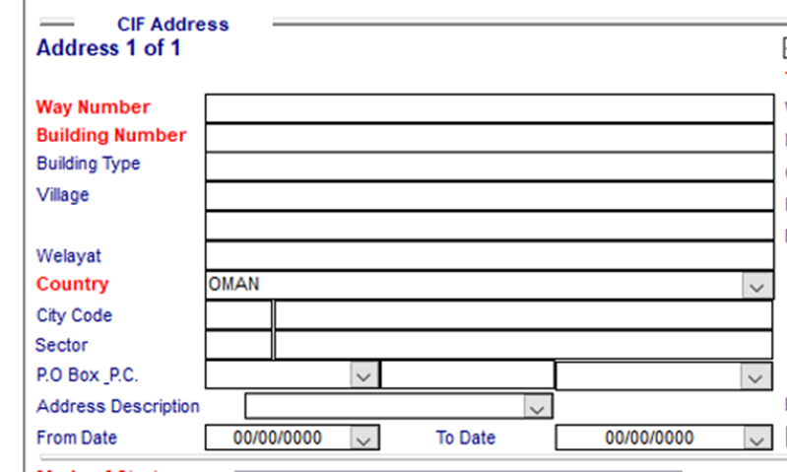
IMAL : Address screen
Existing Required

Slide 11
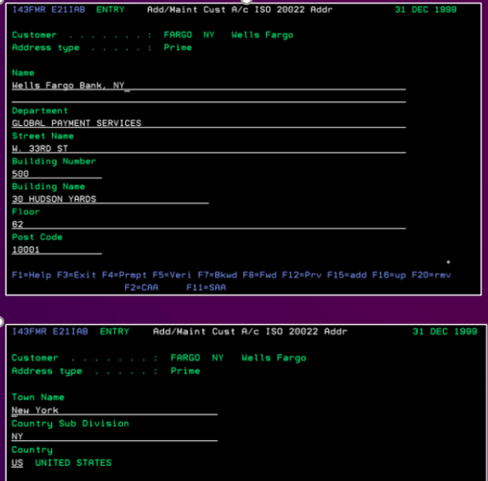

Annexure
EQ : Address screen
Existing Required

Slide 12
IMPACT on ABO SYSTEM
APPLICATION | What is needed? | What will be Achieved?
Equation (EQ) | Upgrade EQ version from EQ439 (2020) to E2024A (2024) | Capability of capturing structured Addresses Must have for being compatibility to structured address module
 | Purchase Additional License to captured Structured Addresses
FPM | Purchase license for translation to MX | Ingest MT message from EQ and generate required MX message Ingest incoming MX message from SWIFT, convert to MT and push the same to EQ
Trade Innovation (TI) | Purchase License to Module to cater to SR 2025 | MX Swift message generation with structured address Handling of incoming MX Transaction
 | Upgrade to latest version
FCC | Purchase License to Module to cater to SR 2025 | Being assessed
 | Upgrade to latest version | Compatibility to latest version of TI
Fusion Teller | Upgrade to latest version | To be compatible with latest EQ version
IMAL | Digital hub module to be purchased
CARS | To be upgraded to latest version
Channels | To be assessed

Slide 14
PROJECT WORK INVOLVED
Assessment of new features in EQ latest version - WIP
Implementation vendor finalization
Cost finalization and approval
Charting full project charter and plan
Upgrade version implementation in UAT
Testing of all impacted Application
Production movement
Address Data Clean up

Slide 15
IMPLEMENTATION PARTNERS
Vendor | Equation | FPM | TiPlus | FCC | Fusion Teller
Finplement | Yes | Yes | Yes | Yes | Yes
IBC | Yes | Yes | Yes | Yes | Yes
Wipro | No | No | Yes | Yes | No
CBM | Yes | Yes | Yes | Yes | Yes

Slide 16
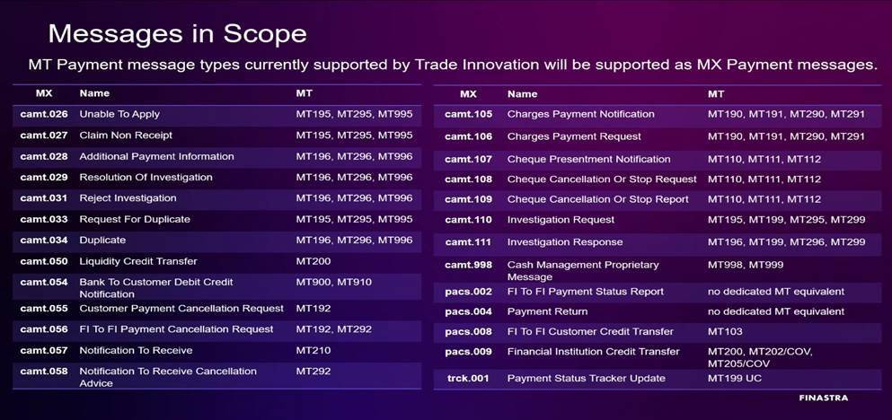
Annexure
IMAL : Address screen
Existing Required

Slide 17
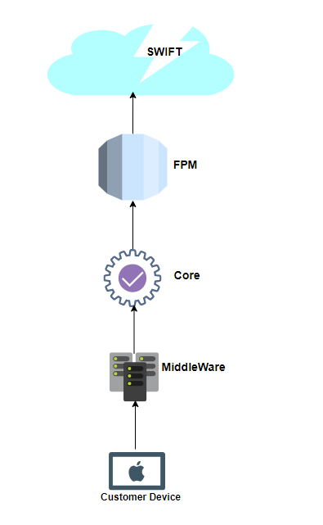
SWIFT FLOW

